Slide 1
The Gulf Coast in the US Recovery: Last In, First Out?
Robert W. Gilmer
Vice President and Senior Economist
Federal Reserve Bank of Dallas
February 2010

Slide 2
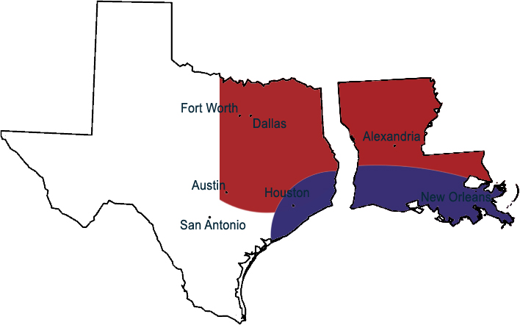

Slide 3
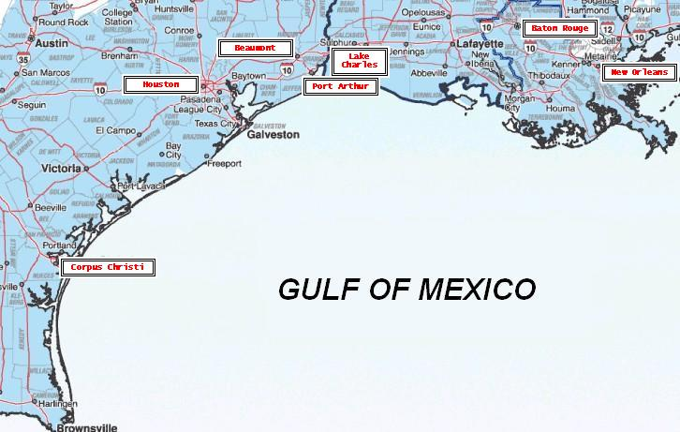

Slide 4
Two Contrasting Portraits of Gulf Coast vs Inland Economies
The Gulf Coast is a vast energy complex of upstream and downstream activity, held together by a web of ports, railroads, and pipelines. Each city is different, but there is a common core of often dominant energy-related activity.
The inland cities have oil exploration, though less than the Gulf Coast. They produce electrical machinery, computers, and have a strong high-tech presence. Dallas is the region’s financial center, and an important point of distribution for Texas, Louisiana, Oklahoma, and Arkansas.

Slide 5
Population of Gulf Coast and Inland Metro Areas, 2007
(Thousands)
Gulf Coast |  |  | Inland
Baton Rouge | 796.4 |  | Alexandria | 152.6
Beaumont | 376.4 |  | Austin | 1592.6
Corpus Christi | 413.1 |  | College Station | 203.2
Houma | 201.0 |  | Dallas-Ft Worth | 6153.4
Houston | 5598.0 |  | Killeen | 370.8
Lake Charles | 191.9 |  | Lafayette | 256.3
New Orleans | 1109.4 |  | Longview | 203.2
Victoria | 113.5 |  | Monroe | 172.2
 |  |  | Sherman | 118.1
 |  |  | Shreveport | 387.5
 |  |  | Texarkana | 134.2
 |  |  | Tyler | 198.0
 |  |  | Waco | 227.8
Total | 8,799.7 |  | Total | 10,169.9
Houston as % | 63.6% |  | DFW as % | 60.5%

Slide 6
Recent Economic Performance

Slide 11
Houston Business Cycle Index Peaked in August 2008, Down 8.0 Percent

Slide 12
Texas Decline Is Shared throughout the Texas Triangle
(Business Cycle Indexes)
Region | Peak | % Decline to Date
Statewide | June/July 2008 | -5.5
Texas Triangle
Houston | August 2008 | -8.0
Fort Worth | May 2008 | -3.4
Dallas | May 2008 | -6.9
San Antonio | April 2008 | -7.8
Austin | February 2008 | -8.8

Slide 13
Purchasing Managers’ Index
US and Houston Compared

Slide 16
Beaumont-Port Arthur Metro?

Slide 20
External Forces that Drive the Gulf Coast Economy
US Economy
Global Economic Conditions
Oil and Natural Gas Markets

Slide 21
US Recovery Is Underway – Sluggish but Real

Slide 22
Overall Coincident Index Shows Clear
Signs of A Cyclical Bottom
Notes:
Again a decline of roughly 7% since summer of 2007.

Slide 23
Leading Index Pointed to Cyclical
Bottom By Autumn

Slide 24
GDP Is Best and Broadest Measure of Economic Growth

Slide 25
Gross Domestic Product
Quarterly Percent Growth, Chained 2000 Dollars
Notes:
25

Slide 26
Divide GDP into Inventory Change and Final Sales
GDP = Final Sales + Inventory Change
Final Sales = C + I_{f} + G + X – M
Final Sales are sales from current production
Change in inventory is negative, it is draw of past production for current use
Change is inventory is positive, it is current production held for future sales

Slide 28
Job Market Improves Slowly, Unemployment Rate Will Lag Recovery

Slide 29
U.S. Employment Growth
In Thousands of New Jobs per Month,1983 to 2008
2007
2008
Average monthly loss in 2008 = 302,000,
2009 = 398,00 0 →
Notes:
29

Slide 30
US Unemployment Rate Reached Highest Level Since 1981-82 Recession

Slide 31
Industrial Production: Manufacturing Has Turned with the Economy
2001 Recession and Jobless Recovery

Slide 32
What Happened?
Autos and Housing Drive the Decline

Slide 33
Million units, annual rate
Notes:
33

Slide 35
Housing Weakens, Strength Elsewhere Evaporates
Notes:
35

Slide 36
Year over year changes*:
New starts +35.6
New home sales -6.1%
Existing home sales 44.1%
Existing home price -4.3%
*12-month change Jan tp Jan
Notes:
36

Slide 37
NAHB Housing Market Index
Shows Continued Pessimism
Notes:
37

Slide 38
Percent of Local Families that Can Afford Median-Priced Home
 | 1999:Q4 | 2009:Q3 | Low Point
United States | 64 | 70 | 40
Los Angeles | 43 | 40 | 2
New York | 55 | 19 | 5
Las Vegas | 69 | 85 | 27
Washington | 70 | 71 | 21
Miami | 59 | 56 | 10
Chicago | 61 | 66 | 40
Dallas | 64 | 69 | 54
Houston | 66 | 70 | 47
Atlanta | 73 | 79 | 64
Source: Wells Fargo Housing Opportunity Index, by metro area or major division
Notes:
38

Slide 40
Existing US Home Sales Stabilized in 2008, Improved in 2009
(million units)

Slide 41
After Long Decline, New Single-Family Construction Begins to Turn

Slide 42
Texas and Gulf Coast Shared in the Housing Bust

Slide 43
Use of High-Cost Mortgages By Metro Area (Percent of Mortgages in 2006)
Detroit 37.2%
Miami 45.1%
Dallas-Fort Worth 29.4%
Houston 33.9%
Los Angeles 32.3%
Washington, DC 22.7%
Phoenix 31.2%
Chicago 27.2%
Boston 17.7%
Atlanta 25.6%
Philadelphia 18.4%
New York 22.4%
San Francisco 22.4%
Source: Home Mortgage Disclosure Act
Notes:
43

Slide 44
Housing Opportunity Index on the Gulf Coast
City | 2000-Q1 | 2008-Q4 | Low
Beaumont | 80.6 | 85.6 | 61.9
Baton Rouge | 77.2 | N/A | N/A
Corpus Christi | N/A | 69.9 | 39.9
Houma | 76.4 | N/A | N/A
Houston | 66.2 | 73.2 | 47.4
New Orleans | 67.2 | N/A | N/A
N/A = Not Available

Slide 45
Houston Association of Realtors.
Notes:
45

Slide 46
Source: Census and TAMU Real Estate Center
Notes:
46

Slide 50
Consumer Bears Brunt of the Post-Recession Adjustment

Slide 51
Retail sales, ex autos and gasoline
2004-2009
Monthly change at annual rates
Dec to Dec changes
Seasonally adjusted data
Notes:
51

Slide 52
Notes:
52

Slide 53
Episodes of Declining Net Worth
% decline home stocks and
net worth equity mutual funds
1968:4-70:2 -8.2 +7.6 -41.0
1973:1-74:3 -12.0 -8.2 -54.8
1989:4-90:3 -4.4 -5.5 -19.4
2000:1-02:3 -13.7 +27.3 -50.0
2007:2-09:1 -24.1 -36.8 -44.3

Slide 54
Wealth and Home Equity Declines
Have No Modern Precedent

Slide 55
 | Gross Product (Annual %) |  | Unemployment Rate (%) |  | Industrial Production (% Annual Rate)
 | Blue Chip | Philly Fed | Blue Chip | Philly Fed | Blue Chip | Philly Fed
2010 | 2.8 | 3.0 | 10.0 | 10.0 | 4.2 | 4.8
2011 | 3.1 | 2.9 | 9.8 | 9.2 | 4.4 | 4.4
2010 Q1 | 2.9 | 2.7 | 10.2 | 9.9 | 5.0 | 5.4
2010 Q2 | 2.8 | 2.7 | 10.1 | 9.9 | 4.5 | 5.1
2010 Q3 | 2.9 | 2.7 | 9.9 | 9.8 | 4.4 | 5.1
2010 Q4 | 3.0 | 2.7 | 9.8 | 9.7 | 4.5 | 5.1
2011 Q1 | -- | 2.7 | -- | 9.4 | -- | 3.0

Slide 56
Current US Outlook
The U.S. economy slipped into recession in December 2007, and the financial shock last fall tilted it into one of the most serious recessions of the last 50 years.
Recovery is underway – both financial markets and the real economy continue to improve. The economy is still weak -- and relapse is possible with any shock.
The consumer has pulled back hard on spending. Losses in wealth are unprecedented due to the decline in home prices, and losses in financial markets. The weak job market adds to cautious consumer spending. Major long-and short-term adjustments in spending and saving occur here.
Recovery? Whether recovery is fast or slow, expect the following expansion to be slow for a prolonged period. There is still much to sort out in autos, housing, and financial industries.

Slide 57
The global economy drives the commodity boom … and now the bust?

Slide 59
Oil Part of a Wider Commodity Boom

Slide 60
What Was Behind the Commodity Boom?
Primarily, it is the growth of the developing world. From 2002-2007, the IMF estimates they account for 90% of the growth in consumption of oil, 90% of metals’ growth, and 80% of food.
Dollar depreciation raises the purchasing power of other currencies, and stimulates the demand for commodities priced in dollars. Raises the price to US consumers.
Low U.S. interest rates (other things equal) can raise the price of commodities by lowering the price of storage, encouraging speculation.
Notes:
60

Slide 61
IMF Global Growth Projections Slowly
Catch Up to Reality
Date Forecast Prepared | 2008 | 2009
October 2007 | 4.4 | --
January 2008 | 4.1 | --
April 2008 | 3.7 | 3.8
July 2008 | 4.1 | 3.9
October 2008 | 3.9 | 3.0
November 2008 | 3.7 | 2.2
January 2009 | 3.4 | 0.5
April 2009 | 3.2 | -1.3
July 2009 | 3.1 | -1.4
October 2009 | 3.0 | -1.1

Slide 62
IMF World Economic Outlook
Annual Percent Growth
 | 2007 | 2008 | 2009 | 2010
World | 5.2 | 3.0 | -1.1 | 3.1
US | 2.1 | 0.4 | -2.7 | 1.5
Devel. Asia China | 10.6 13.0 | 7.6 9.0 | 6.2 8.5 | 7.3 9.0
Euro Area | 2.7 | 0.7 | -4.2 | 0.3
Japan | 2.3 | -0.6 | -5.4 | 1.7
Source: IMF, World Economic Outlook, October 2009
Notes:
62

Slide 63
Could Emerging Country Growth Really Decouple from the US, Europe and Japan?
Strong internal growth dynamics
A rising share of the global economy
More resilient policy framework
But spillovers from the developed world still a factor – accounting for maybe 35 percent of growth for emerging economies, 45 percent for more commodity dependent
Notes:
63

Slide 64
Recent Forecasts for Asia in 2010
IMF (October): Developing Asia, 7.3%; China, 9.0%
UN (June): East Asia, 5.6%; South Asia, 5.6%
World Bank (June): East Asia less China, 3.5%; China, 7.5%
OECD (September): China, 9.25%; Indonesia, 4.8%

Slide 65
Oil and natural gas have separated Houston from the rest of the country for the last four years …

Slide 66
Refiners’ Acquisition Cost of Crude Oil
1994 to Present

Slide 67
Wellhead Price of Natural Gas
1994 to Present

Slide 68
International Rig Count Continues to Hold Up
Excludes Iran and the Sudan
Notes:
68

Slide 70
High Oil/Low Gas Price Push Drilling
Toward Oil-Directed Activity

Slide 71
Horizontal Drilling Strength Shows the Growing Strength of Shale Gas

Slide 72
Texas Drilling Peaked at Same Time as US
Then Fell Further, But Now Recovering

Slide 73
Natural Gas-Directed Drilling
Good News
  Natural gas marketed production still up 1.2 percent this year from last year, but may have finally peaked over the summer
  Rising oil prices now providing some support for gas prices
Bad News
  Industrial loads hurt by recession
  Inventories 15-20 percent above normal, near capacity going into heating season. Excees cut in half by cold winter.
Worse News
  Technology is too good, shale more prolific than expected.
  Longer-run, will we need 1600 gas-directed rigs to maintain current level of production? Probably not

Slide 74
Notes:
74

Slide 75
Oil and Natural Gas Mining Jobs in Houston: 1990 to Present

Slide 76
Houston Shows Growth in Both Producer and Oil Service Jobs

Slide 77
Manufacturing Jobs in Houston
1990 to Present

Slide 78
Downstream boomed, too. Now feeling pain of slow growth …

Slide 79
$8.60/bbl
←$2.97/bbl
$3.64/bbl →

Slide 80
US Heating Oil and Diesel Inventory:
Percent Deviation from Five-Year Average

Slide 82
Ethylene Margins
Cash Margins, Ethane

Slide 85
New Hydrocarbon Project Announcements
Texas and Louisiana Gulf Coast, 1986 to Present
No. of Projects

Slide 86
What does it mean for the Gulf Coast?

Slide 87
The Gulf Coast Reaches the End of a Long Chain of Events
Slow growth turns to recession in the US economy, and then recession worsens
Slowdown in the developing world turns to global recession
A sharp reverse in the commodity boom, and especially in oil markets
Finally, a setback in Houston and the Gulf Coast in 2009. For 2010? Last in, first out? Or last out?

Slide 89
Return of the Boom?
The end of the commodity boom of 2004-2008 reached the Texas and Louisiana Gulf Coast as a major US recession and global downturn drove commodity prices down.
Oil and other commodity prices have improved on Chinese stimulus and a better economic outlook, but natural gas prices seem headed into a period of less near-term activity.
How long? These are cyclical industries, going through another cyclical event. Will Asia get back on the same strong growth path? And can it actually lead global growth? Whether the Gulf Coast leads or lags probably depends on how quickly we re-inflate commodity prices

Slide 90
Houston and the US Recovery:
Last In, First Out?
Robert W. Gilmer
Vice President and Senior Economist
Federal Reserve Bank of Dallas
February 2010

